Slide 1
UNIVERSITY OF BARISHAL
Accounting

Slide 2
Annual Day

Slide 3
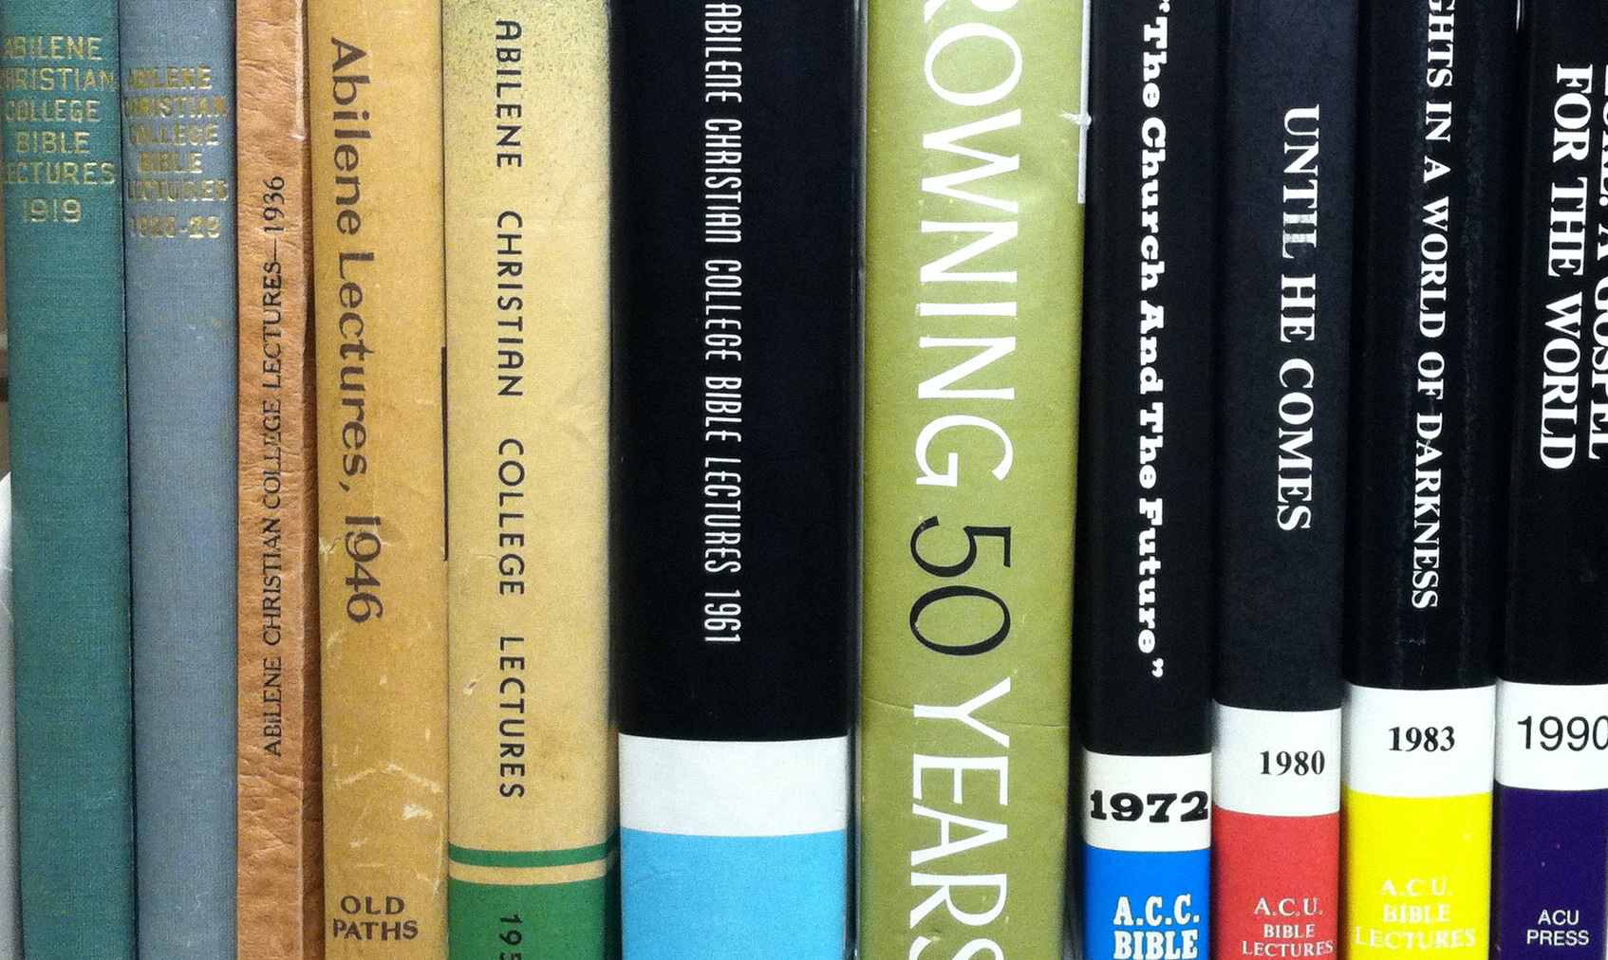
This Photo by Unknown Author is licensed under CC BY

Slide 4
4

